Slide 1


Training of Trainers:
ALLIANCE-BUILDING FOR JUST TRANSITION
Module 1 workshop
Any technical problems:
Louis +27 (0)79 592 2223
Any facilitator problems:
Louise +27 (0)83 309 7590

Slide 2
8:30 | Activity 0: Welcome and opening
8:40 | Session 1.1: The climate crisis demands transitions
 | Activity 1.1.1: Sharing experiences of climate changes
 | Activity 1.1.2: Input on causes, impacts and mitigation
9:40 | BREAK
9:45 | Activity 1.1.3: Explore the social and labour aspects of mitigation actions
10h05 | Session 1.2: What transitions are underway?
 | Activity 1.2.2: Analysing a transition case study
10:55 | BREAK
11h10 | Session 1.3: Developing an agenda for justice in the transitions
 | Activity 1.3.1: Surface justice issues
 | Activity 1.3.2: Integrating gender justice in climate action
 | Activity 1.3.3: Develop shared principles
12:10 | BREAK
12h15 | Rotate and share
12h27 | Wrap up

Slide 3

Concept 1: gases and temperature

Slide 4
Causes of climate change
greenhouse gas emissions
average global warming
climate change
unpredictability, extremes –tipping points
CO₂eq from
oil, coal, cement,
land use, cows, deforestation …
up by ±1.2°C against
pre-industrial levels
Notes:
Speaking notes:
List the greenhouse gases, use farts to explain what a gas is, explain human-caused sources; ask for examples in their sectors from unionists; note that we are all dependant on these activities e.g. Eskom; explain „CO₂-eq“ and the use of „carbon“ for convenience
Explain: how GHGs from anywhere on earth increase average global temperature; time lag between emissions and planet‘s response; pre-industrial baseline; 1.5°C vs 2°C issue which target leads to a global carbon budget
Emphasise climate variability; explain tipping points; see background notes on previous slide for understanding how scientists make these predictions
Ask: What can we change along this cause-and-effect chain? This is mitigation.
Background knowledge and references:
From IPCC Fourth Assessment Report, November 2007:
Atmospheric concentrations of GHGs increase when emissions exceed removal processes.
Greenhouse gases (GHGs) covered by the UNFCCC: carbon dioxide (CO₂), methane (CH₄), nitrous oxide (N₂O), and halocarbons -- hydrofluorocarbons (HFCs), perfluorocarbons (PFCs) and sulphurhexafluoride (SF₆), including fluorine, chlorine and bromine.
Global GHG emissions due to human activities have grown since pre-industrial times, with an increase of 70% between 1970 and 2004. CO₂ is the most important anthropogenic (human-caused) GHG. Its annual emissions have grown between 1970 and 2004 by about 80%, from 21 to 38 gigatonnes (Gt), and represented 77% of total anthropogenic GHG emissions in 2004.
The largest growth in GHG emissions over this period has come from energy supply, transport and industry, while residential and commercial buildings, forestry (including deforestation) and agriculture sectors have been growing at a lower rate.
The rate of growth of CO₂-eq emissions was much higher during the recent 10-year period of 1995--2004 (0.92 GtCO2-eq per year) than during the previous period of 1970--1994 (0.43 GtCO2-eq per year).

Slide 5
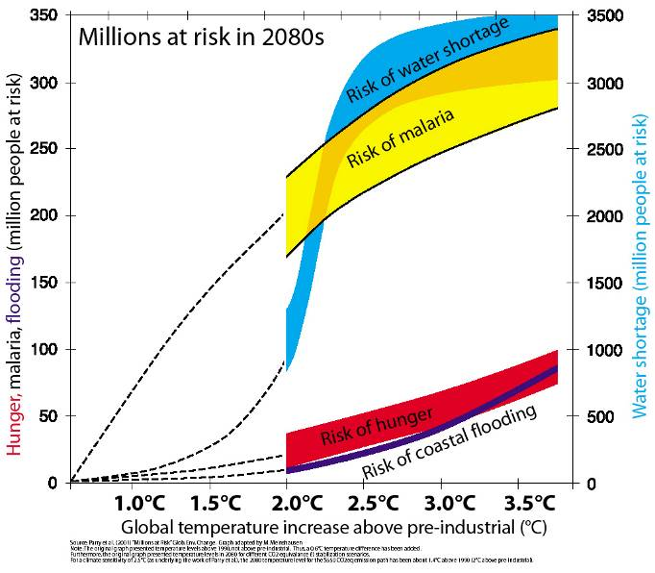
… the climate effects have impacts on humans
evaporation, seasonal
shifts, droughts, floods, species die or move, seas rise …
… fishing,
crops fail, livestock dies, diseases shift …
Notes:
Speaking notes:
Unpack the slide and graph.
Ask: What can we change along this cause-and-effect chain? That‘s adaptation.
Reinforce carbon budget concept, correlated to temperature.
Background knowledge and references:
From Millions at Risk: Defining Critical Climate Change Threats and Targets by M Parry and others, 2001. Graph adapted by M Merchzusen.
Notes on slide in Richard’s presentation to Sasol conference in June 2008: “The original graph presented temperature levels above 1990, not above pre-industrial levels: thus a 0.6°C temperature difference has been added … the original graph presented temperature levels in 2060 for different CO₂eq stabilisation scenarios. For a climate sensitivity of 2.5°C as underlying the work of Parry et al., the 2060 temperature level for the … has been about 1.4°C above 1990 (2°C above pre-industrial).”
From IPCC Fourth Assessment Report, November 2007:
Globally, in the 21st century, at 2090/99, relative to 1980--1999:
Temperature increases 0.3°C to 6.4°C (add 0.5°C to get change relative to 1850--99).
20 to 30% of plant/animal species likely to be at increased risk of extinction at increases over 1.5 to 2.5°C.
The lower limit of sea level rise ranges from over 0.18m to over 0.59m, excluding any rapid ice changes, and cannot provide an upper bound for sea level rise.
Snow cover area is projected to contract.
It is very likely that hot extremes and heat waves will become more frequent.
It is very likely that heavy rainfall events will become more frequent.
It is likely that future tropical cyclones (typhoons and hurricanes) will become more intense, with larger peak wind speeds and more heavy precipitation. There is less confidence in projections of a global decrease in numbers of tropical cyclones.
Storms outside the tropics are projected to move poleward, with consequent changes in wind, precipitation and temperature patterns.
Increases in the amount of rainfall are very likely in high-latitudes, while decreases are likely in most subtropical land regions, up to 20% less – in southern Africa 20% less over June to August.

Slide 6
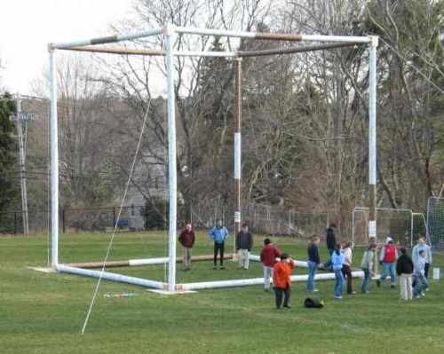
Notes:
Background knowledge and references:
http://www.energyrace.com/commentary/what_does_a_ton_of_co2_look_like/
What Does a Ton of CO2 Look Like?
March 10th, 2008 by jayb
Dave Ames, a science teacher at Cohasset High School in Cohasset, Massachusetts built a large cube that represents the size of 1 ton of carbon dioxide. Take a look.
OK, yes. CO2 (carbon dioxide) is invisible. But it's still interesting to see how much space a ton of CO2 would take up if it were sitting in front of you.
In this case, we are talking about a metric ton of CO2 which is 2,204 pounds. Mr. Ames' cube, built last year with the help of his 9th grade physics students, is 27 feet wide by 27 feet high by 27 feet deep.
This is at sea level pressure.

Slide 7
Measuring emissions
Greenhouse gases =
CO₂eq = carbon dioxide equivalent
Quantity: Megatonnes (Mt = 1 000 000 tonnes)
or gigatonnes (Gt = 1 000 000 000 tonnes)
of greenhouse gases (CO₂eq)
Annual emissions: per year
Parts per million: concentration: number of CO₂ molecules in a million molecules of air
Per capita: how much per person
Emissions intensity: how much per $1
of gross domestic product (GDP)

Slide 8
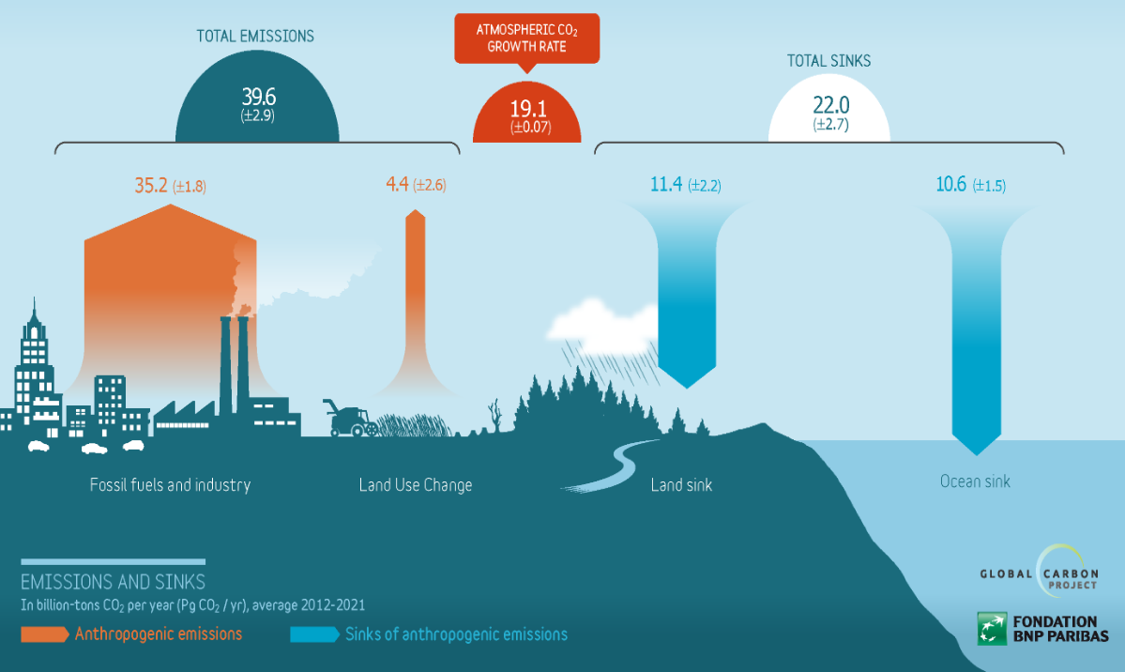
Source: cms2018a.globalcarbonatlas.org/en/content/global-carbon-budget

Slide 9
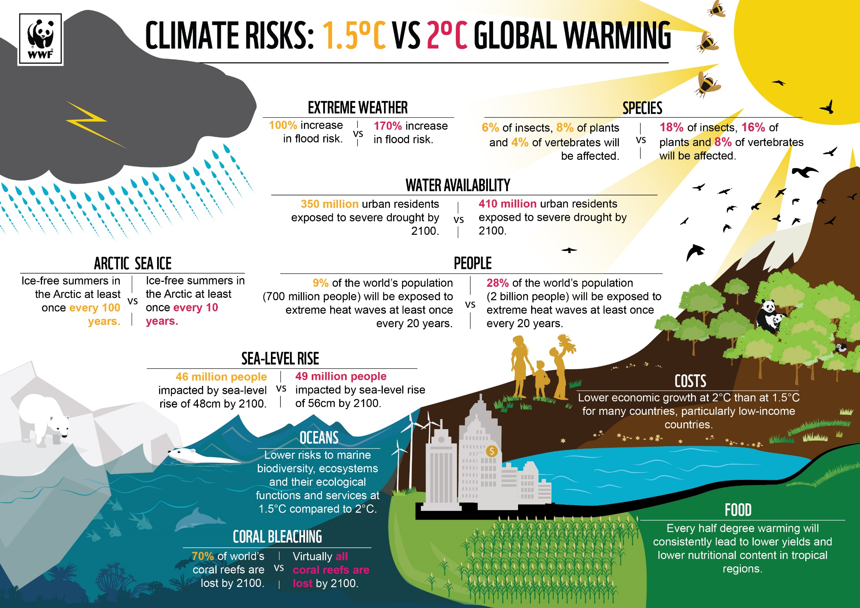
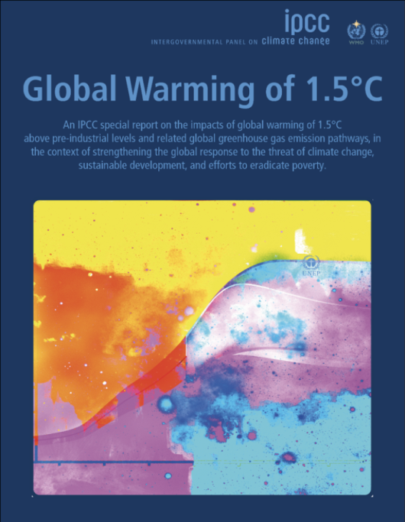

Slide 10
Concept 2: carbon budget

Slide 11
Global carbon budget (from 2020 on)
to stabilise at 1.5 °Celsius warming
for a 67% chance:
We can’t emit more than 400 gigatonnes CO₂
(12 years of 2018 emissions)
for a 50% chance:
We can’t emit more than 500 gigatonnes CO₂
(15 years of 2018 emissions)
EVER
Notes:
Source: www.ipcc.ch/report/ar6/wg1/#SPM

Slide 12
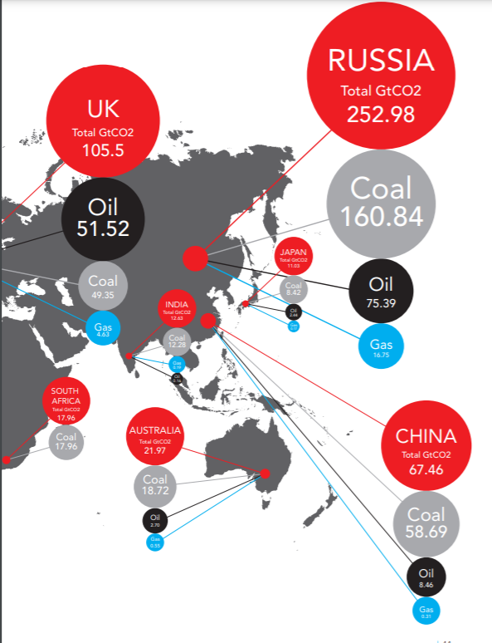
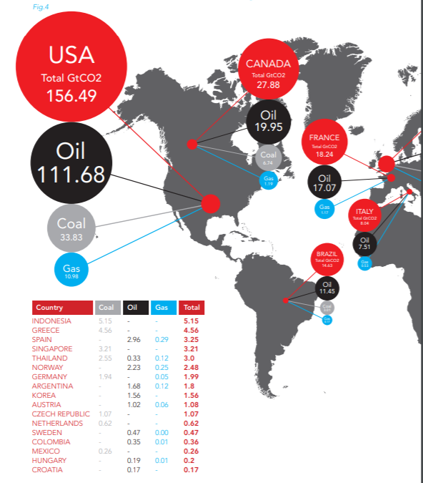
Proven fossil fuel reserves in 2010
Resources are the amount that has been discovered. Reserves are the amount of those resources that a company considers profitable to extract and sell.
x
Notes:
Source: www.banktrack.org/download/unburnable_carbon/unburnablecarbonfullrev2.pdfx

Slide 13
Levels of CO₂ emissions
to stabilise at 1.5 °Celsius warming
by 2030: ±45% less than in 2010
by 2050: net zero by 2050 and beyond

Slide 14
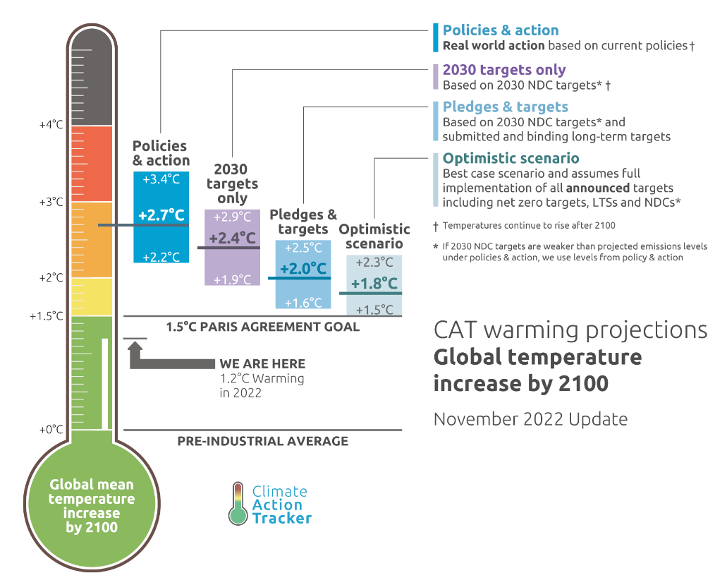
Where we are

Slide 15
Concept 3: two kinds of crises

Slide 16
Biophysical impacts and knock-on effects

Slide 17
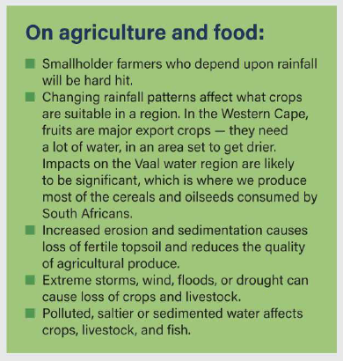
Water impacts on agriculture

Slide 18
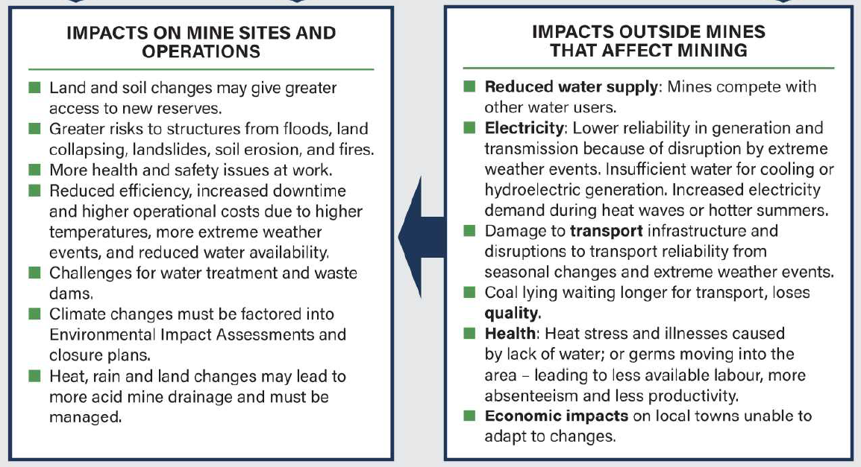
Impacts on mining

Slide 19
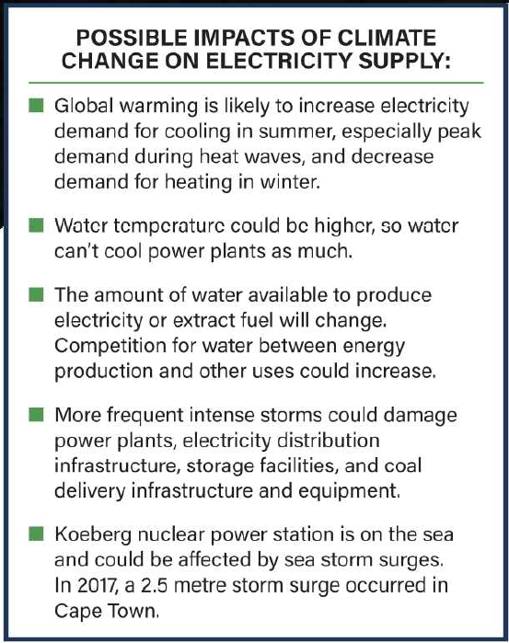
Impacts on electricity supply

Slide 20
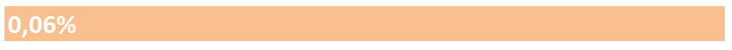
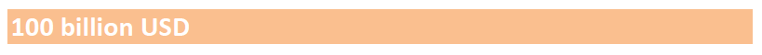
The economic impact (to reach 450 ppm by 2100) is only 0.06% per annum less in global average consumption growth compared to a fossil-intensive pathway.
excluding ‘social cost of carbon’:
avoided climate impacts on people, economies and ecosystems • reduced air pollution from fossil fuels • better human health • enhanced job options • declining fossil fuel import bills • decreased freshwater consumption …
annual global adaptation costs by 2050
Notes:
It does not include the multitude of environmental, social, developmental, cultural and other benefits from a climate-friendly pathway. If social costs of carbon, such as the avoided climate impacts on people, economies and ecosystems, reduced air pollution from fossil fuels, better human health, enhanced job options and declining fossil fuel import bills, decreased freshwater consumption, etc., were to be included in the calculation, the low/zero carbon development pathway would emerge as the absolutely most cost-effective pathway. It is also clear from the report that climate change impacts are projected to slow down economic growth and make poverty reduction more difficult.

Slide 21
Transition challenges

Slide 22
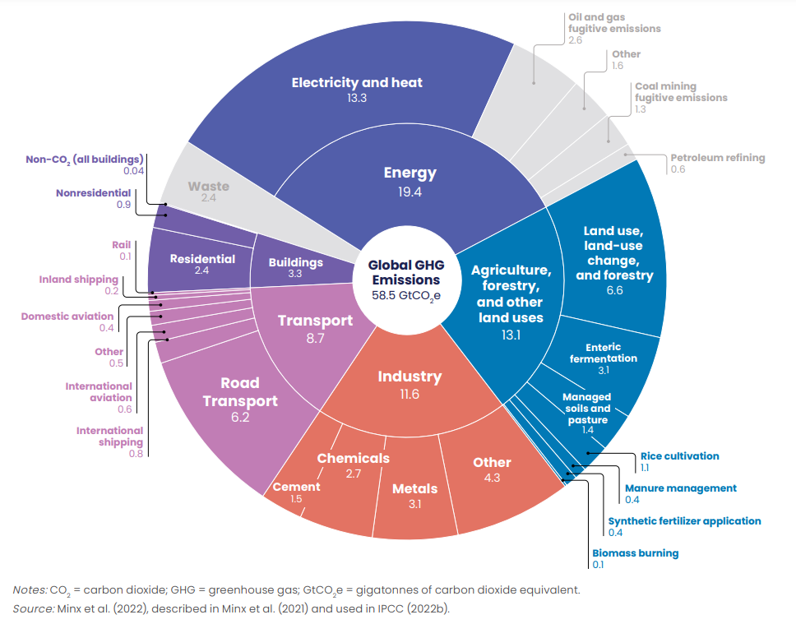
Notes:
In 2019
https://climateactiontracker.org/documents/1083/2022-10-26_StateOfClimateAction2022_kR0sbBZ.pdf

Slide 23
Concept 4: equity

Slide 24
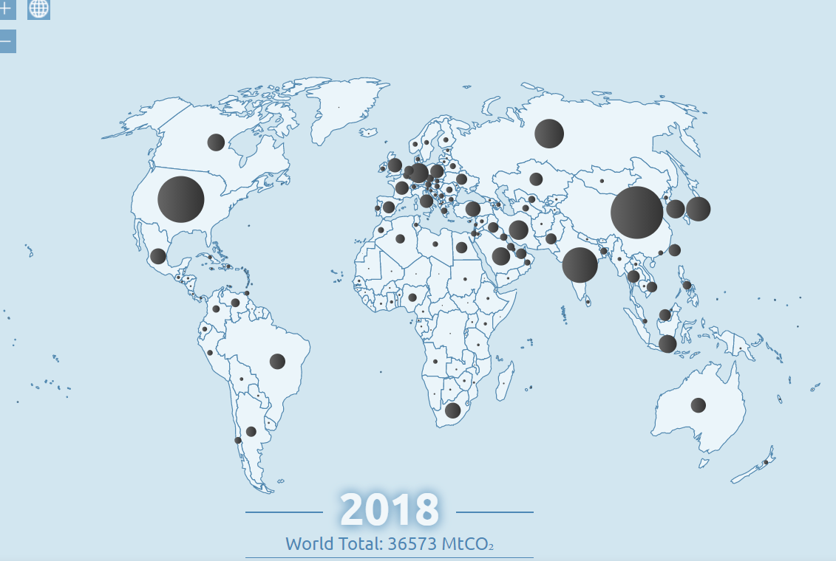
Geopolitical
equity
Notes:
http://www.globalcarbonatlas.org/en/CO2-emissions

Slide 25
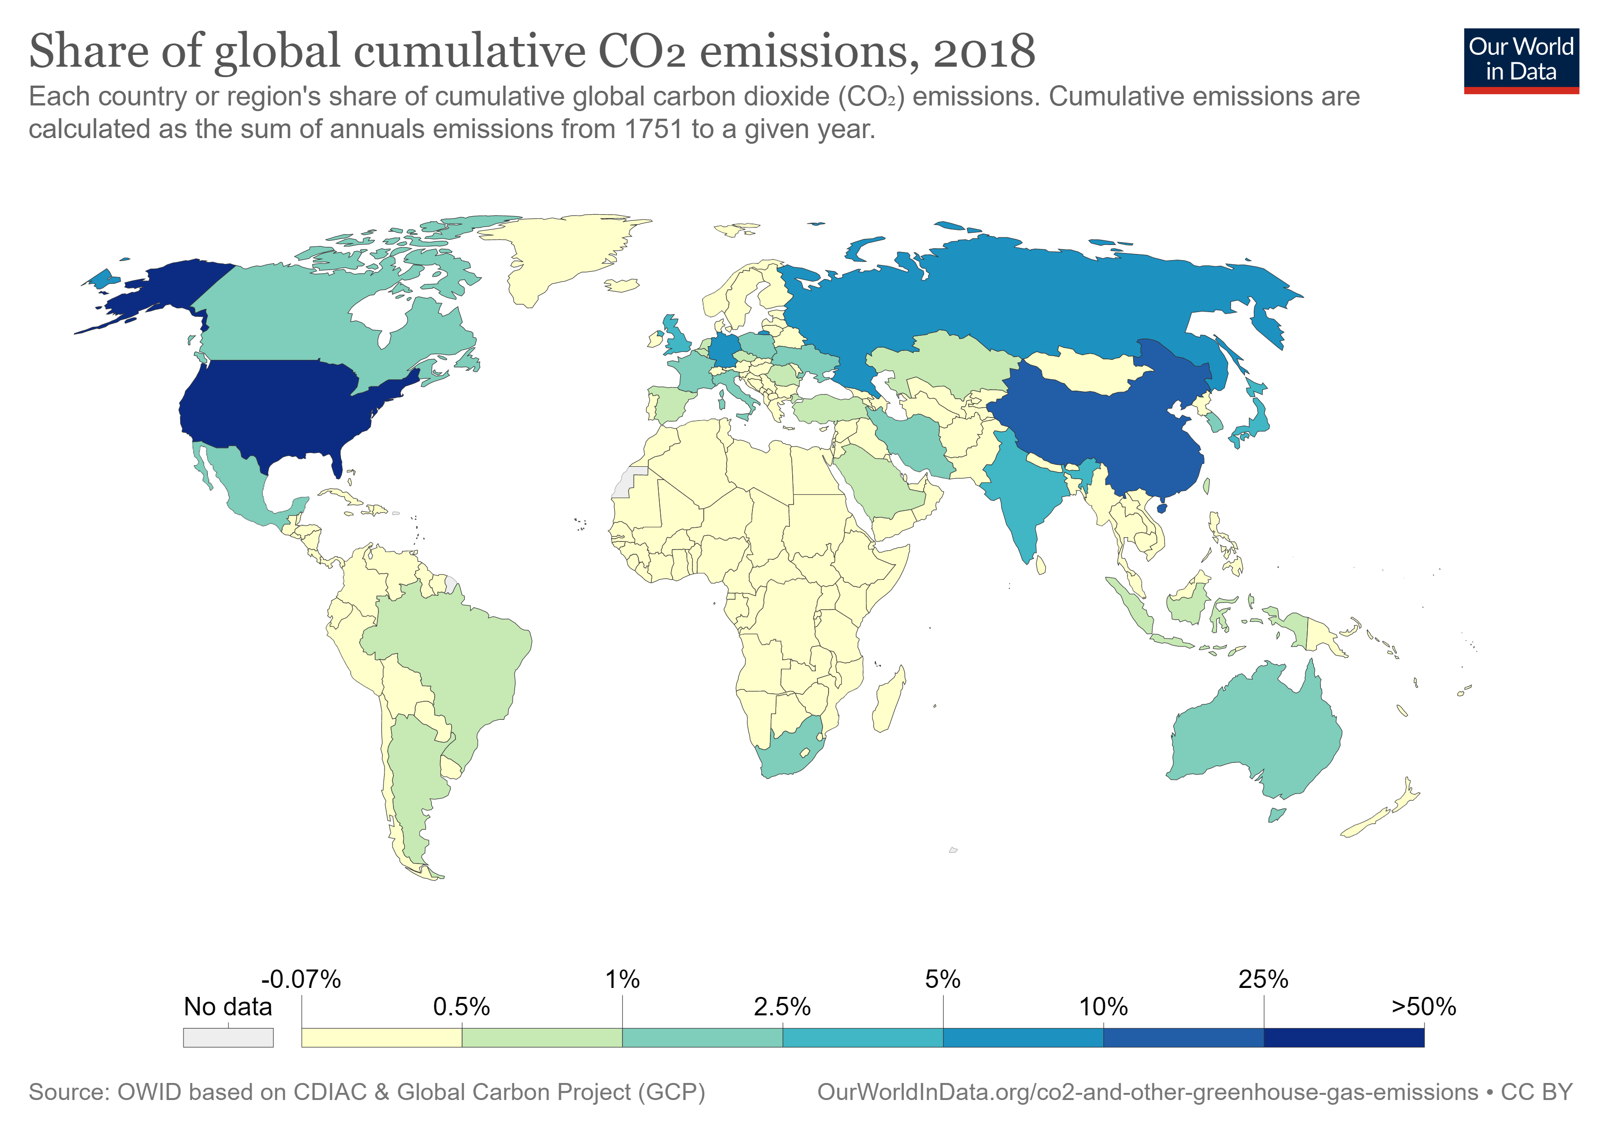
Notes:
https://ourworldindata.org/co2/country/south-africa?country=~ZAF#what-share-of-global-co2-emissions-are-emitted-by-the-country

Slide 26

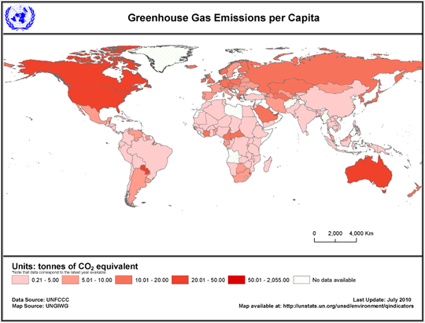
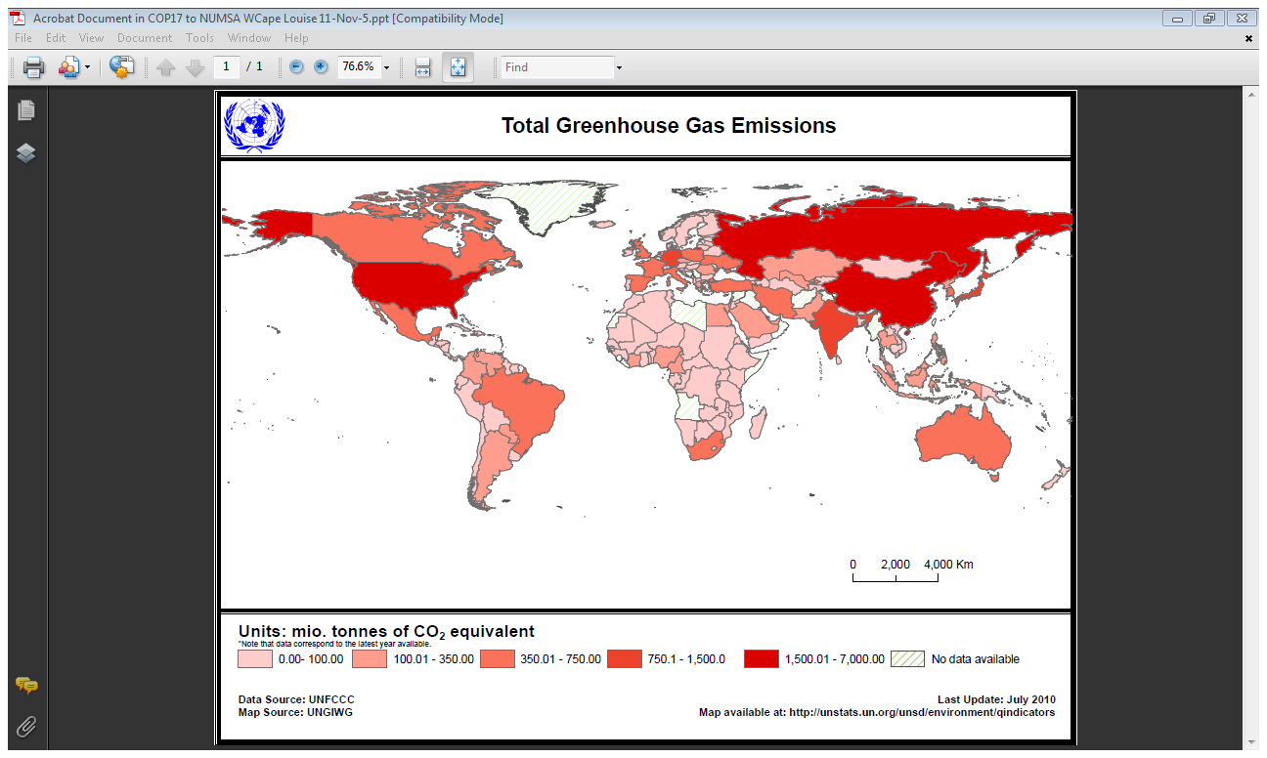


Equity: emissions per capita
Canada
Russia
BASIC
Libya
Saudi Arabia
Algeria
USA
Japan
BASIC
Nigeria
BASIC
Angola
BASIC
Australia
NZ
Notes:
http://unstats.un.org/unsd/environment/air_greenhouse_emissions.htm, accessed 2/11/11
Data souce UNFCCC, map source UNGIWG, last update July 2010
Data on greenhouse gas emissions are usually estimated according to international methodologies on the basis of national statistics on energy, industrial and agricultural production, waste management and land use, etc. The best known and most widely used methodology is the 1996 Guidelines of the Intergovernmental Panel for Climate Change (IPCC) (see http://www.ipcc-nggip.iges.or.jp/public/gl/invs1.htm) which is the basis for reporting to the UNFCCC. The latest revision and update of this guideline is 2006 IPCC Guidelines for National Greenhouse Gas Inventories
(see http://www.ipcc-nggip.iges.or.jp/public/2006gl/index.htm). G
HG emissions per capita is calculated by UNSD. For some non-Annex I countries, the GHG emissions data may be incomplete because they include only emissions from a few available sources and therefore do not represent the absolute total emissions of the country. For detailed information (http://unfccc.int/ghg_data/ghg_data_unfccc/data_sources/items/3816.php).
Data Quality: Countries report their greenhouse gas emissions to UNFCCC according to the IPCC Guidelines. The quality of data is regularly checked through the UNFCCC review process for the Annex I Parties to the Convention that report the data annually. Non-Annex I countries do not report the data annually and their data are not subject to the same review procedures. Data quality depends on the quality of statistics underlying the calculations or estimates and is usually the best for energy related emissions; because of differences in completeness and quality of the estimates, the data should be used with caution when comparing countries.

Slide 27
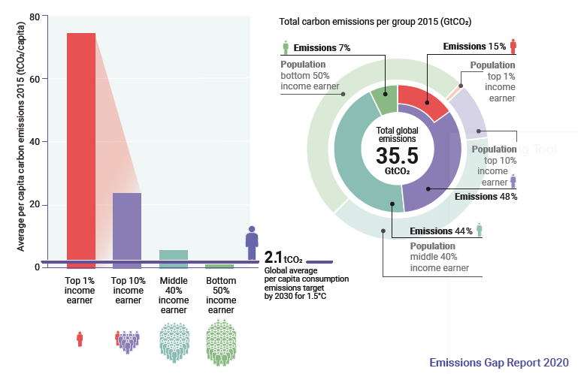
Equity: income groups
Notes:
https://drive.google.com/drive/u/0/folders/1jyIORgkQptJ9vfLPV4ozngWGZy0xf_Tn
United Nations Environment Programme (2020). Emissions Gap Report 2020. Nairobi.

Slide 28
Equity: income groups

Slide 29
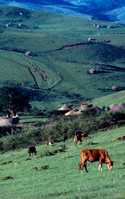
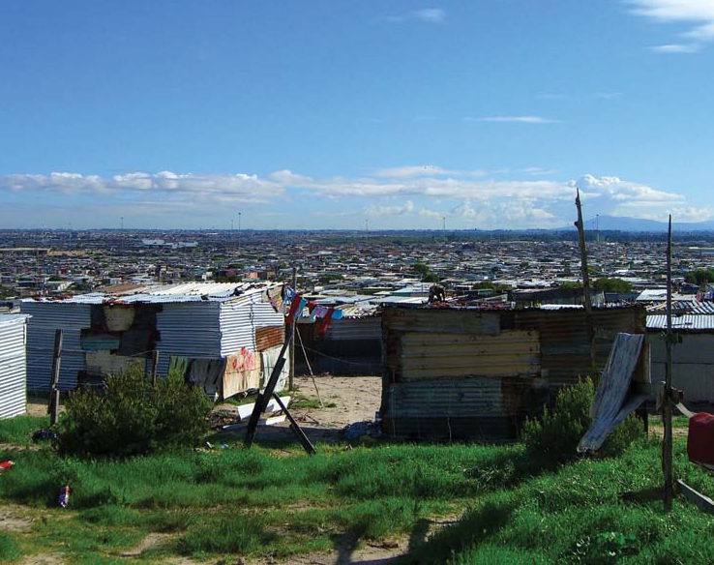
Socio-economic equity

Slide 30
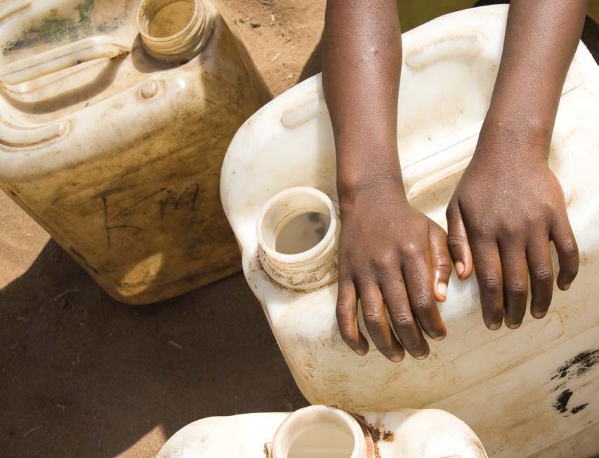
Gender equity

Slide 31
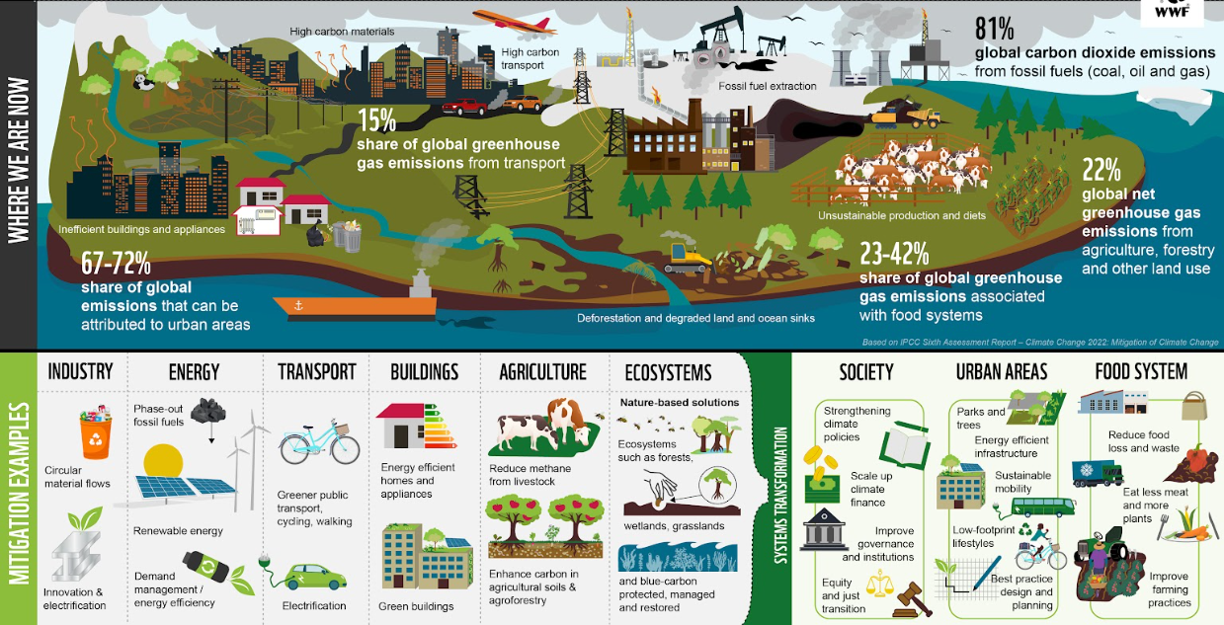
Activity 1.1.3
Manual page 21 – pick one of the mitigation examples

Slide 32
Activity 1.1.3
  What could be the negative and positive impacts on workers and the working class?
  Would this initiative affect women and men differently?
Write one idea in the Chat. Write: initiative: idea

Slide 33
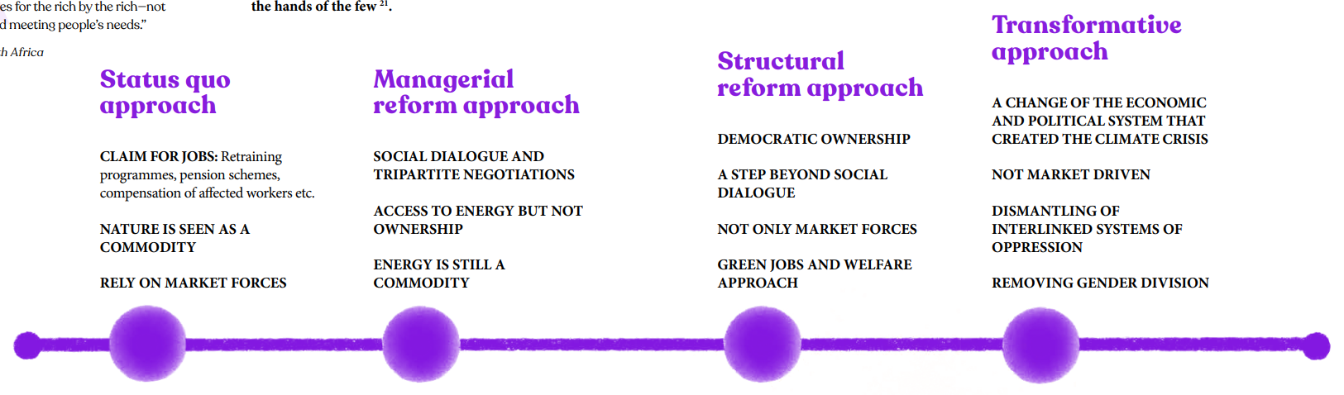
Activity 1.2.2
Manual page 25

Slide 34
Activity 1.2.2
 | Page number in Manual  | Colombia | South Africa | Spain
1 | Political economy | 44 | 52 | 64
2 | Stakeholders and their interests | 45 | 53 | 65
3 | Justice issues | 48 | 57
4 | Transition processes | 49 | 58 | 68
5 | Challenges and successes | 50 | 59 | 72
6 | Outcomes and current state |  | 61

Slide 35
Activity 1.2.2
  Do you think this case study reflects an approach of Status Quo / Managerial Reform / Structural Reform / Transformative Approach?
  What could be done to drive a more transformative approach in this country?

Slide 36
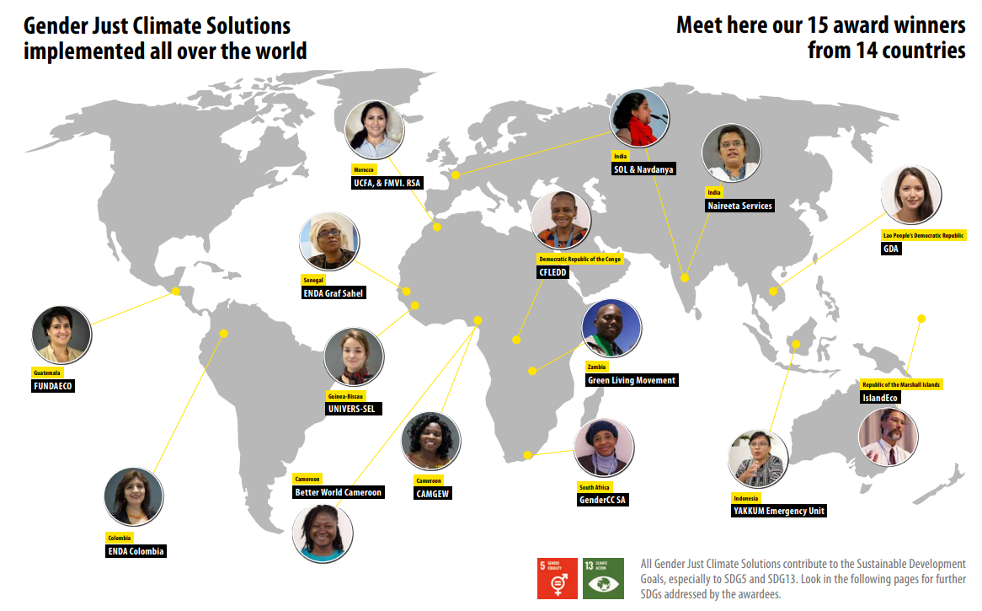
Activity 1.3.2
  ● What inspires you about the project
  ● How does it help with climate change or the transition?
  ● In what ways is it “gender just”?
  ● What other justice issues does it address?
Links in Chat (English, French, Spanish) pages 9 to 23 – pick one

Slide 37
Page number in Manual 
• Economy | 83, 84, 85
• Work • How we live | 86
• Water • Food • Energy • Mobility • Health • Land | 87, 88
• Climate justice • Social justice | 89
• Solidarity | 90
• Geopolitics / imperialism • Participatory democracy | 91
  ● What ideas does the group agree with?
  ● What ideas does the group have problems with?
  ● Are there other principles or ideas that are missing?
  ● What principles are you going to adopt for your just transition?

